Slide 1

Qr code based attendance system
By: Sathkeerthi y Agnihothri shrivathsa rao bv Vamshi m jois
Synopsis link: https://drive.google.com/file/d/1lzZ....=sharing

Slide 2
The team members
Sathkeerthi Y Agnihothri – 4NI19CS099
Shrivathsa Rao BV – 4NI19CS104
Vamshi M Jois – 4NI19CS119
Guide -
Poornima N, Assistant Professor, Dept of CSE, NIE.
Mentor –
Dr. Jayasri BS, Professor, Dept of CSE, NIE.

Slide 3
Overview of the presentation
Existing System
Proposed System
Scope of the project
Hardware and Software requirements
Conclusion
References

Slide 4

Existing system
Currently, attendances are maintained through manual entry, and will be carried out in the handwritten registers, and attendance is taken mid session of a lecture.
Drawbacks of Existing System:
Lots of paperwork: Existing system requires lots of paperwork. Loss of even a single register/record leads to loss of authenticity.
Time consuming: Since attendance taking is the task of the lecturer, productive time is wasted in taking attendance in precise fashion, and same time could be used to teach more in a session.
Time-specific bound attendance monitoring isn’t possible.

Slide 5
Proposed system
The proposed system uses QR-code method for authenticating Students with a unique QR-code that represents their unique id.
Every Student is provided with a card that contains the QR-code.
Features of Proposed system:
GUI mini interface is used before scanning QR Codes.
The QR code is a two-dimensional code which has black squares arranged on a white background which efficiently stores data.
A QR code can be embedded anywhere, here it is embedded on the ID card.
The QR code could be scanned by camera or QR code Scanner.
QR codes are unique, so it differs from one student to other.
After Scanning the QR code the system will generate a report that contains the names of the present, along with their class info and check-in time.

Slide 6

Scope of the project
Attendance system is a method of maintaining records of people in an institution or organization.
Thus this project is quality of life improvement in schools, colleges and universities which all need to maintain the records of students and teachers everyday.
Very much viable to use in corporate world, because there is no delegation of attendance maintenance work to anyone and calculate employee salaries.

Slide 7
Hardware / software requirements
QR code scanner / laptop with webcam
Processors: Intel Atom® processor or Intel® Core™ i3 processor
Disk space: 1 GB
Operating systems: Windows 7 or later, macOS, and Linux
Python versions: 2.7.X, 3.6.X
Python modules: MyQR, TKinter(tk, tk-tools), pyzbar, CV2 (opencv-python)
Pre-generated QR code cards

Slide 8

Conclusion
The working model aims to improvise the existing system by a ton and improve quality of life.
This is a cost efficient, yet fully functional method of attendance automation which integrates as front interface for monitoring and recording.
Accurate time-bound attendance generation in easily modifiable and effortlessly convertible Excel sheet format is highly desirable, that makes it a must have in technically forward institutions.

Slide 9

References
Learning Python, Mark Lutz, O‟Reilly Media, 5th Ed.
Official Python Documentation: https://docs.python.org
YouTube: https://www.youtube.com
Full Stack Python: https://www.fullstackpython.com
Stack Overflow: https://stackoverflow.com

Slide 10
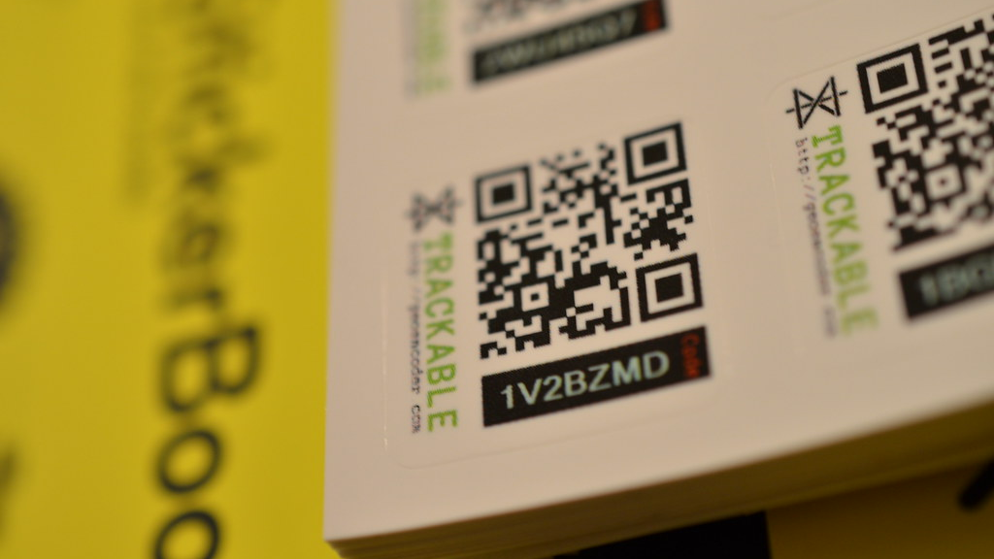
Thank You
This Photo by Unknown Author is licensed under CC BY-NC

